Slide 1
Webinar for Beneficiaries
of the 1st calls for project proposals
Interreg NEXT
Black Sea Basin Programme
Webinar
- Financial & reporting aspects -
25 March 2025

Slide 2
Webex meeting
Please turn OFF video;
During presentations, please keep your microphones muted;
Please use the chat for asking questions;
Q&A session will be organized after the presentation.

Slide 3
Personal data protection notification Regulation (EU) 2016/679
Please note that this meeting will be video and audio recorded and the information collected shall be used for communication and information purposes.
The photographs and/or videos taken during the event can be used on social media, on the Programme’s website and for the Programme’s communication and information activities.
Personal data collection, processing and storage shall be performed by MA according to the provisions of the Regulation (EU) 2016/679 for the purpose of implementation of the Programme, including archiving and statistics, by taking all technical and organizational measures necessary in order to ensure the integrity and confidentiality of your personal data.
Any personal data processed by MA may also be transferred only to other bodies with responsibilities as regards the Programme.
By attending this meeting you agree on the collection and on processing of your personal data as described above.
If you do not agree with the personal data collection and processing for the mentioned purposes, please turn off your camera and microphone.

Slide 4
TOPICS OF TODAY
Common mistakes in reporting
REMINDERS - What to consider
Questions and answers

Slide 5
COMMON MISTAKES IN REPORTING
Costs reported do not respect the description / details / amounts of the sub-budget lines from the approved budget from the Application form.
E.g.:
Costs reported for 4 participants to an event, but only 2 participants were mentioned in the budget of the Application form.
Staff costs not reported separately, per each month, per each member of the project staff.
Salary taxes were not broken down per each member of the project staff, but reported as a single amount per each month for all staff members.
Staff costs exceeded the amounts budgeted in the sub-budget lines of the Application form.
Equipment/External expertise – providing documents with global amounts which refers to different sub-budgetary lines, which can not be or hardly be identified by the controllers/auditors or MA.

Slide 6
COMMON MISTAKES IN REPORTING
Costs reported under the wrong budget line
WRONG
E.g.:
Travel & accommodation costs for staff reported under budget line External expertise and services;
Per diem costs reported under budget line Staff costs;
Travel & accommodation costs for external experts reported under budget line Travel & accommodation
CORRECT – see Regulation (EU) 2021/1059 (Interreg)
E.g.:
Travel & accommodation, per diem for staff, personnel or management staff of the partner(s) who execute tasks directly related to the project, are reported under budget line Travel & Accommodation - Article 41;
Travel & accommodation for external experts, speakers, chairpersons of meetings and service providers, are reported under budget line External expertise and services - Article 42.

Slide 7
MONITOR THE BUDGET EXECUTION!
WHAT ?
Reported costs (in EURO) ≤ the total amount (in EURO) of the sub-budget line
and
Reported no. of units of the sub-budget line = no. of units in the application in force
Clear correspondence between the declared costs and the sub-budget lines in the application
in Jems field “Comment” from section “List of expenditures” should be filled in with the name of the corresponding sub-budget line of the application in force;
HOW?
Costs (in EURO) declared/certified in all the reports (previous and current) prepared / submitted to date must not exceed the total amount of the sub-budget line in the approved application.
export the global list of expenditure from Jems section “Report export”,
filter the costs by column “Comment”,
sum up all the costs related to the respective sub-budget line,
compare with the total amount of the respective sub-budget line.

Slide 8
BUDGETARY MODIFICATIONS vs. DECLARED COSTS
The expenditures declared in a financial report must be correlated with the last approved budget in the application form (in force at the moment of the submission of the report to the controllers).
During ongoing verification of a report, can be requested any budget modifications to the sub-budget lines where expenditure have been declared?
YES
NO
only if the modifications do not have an impact on the expenditure declared
E.g.: a request to supplement an amount of a sub-budget line, with the purpose of ensuring funds for an expenditure that exceeded the funds included in the respective sub budget line

Slide 9
COMMON MISTAKES IN REPORTING
LINK BETWEEN COSTS AND PROCUREMENTS SECTION IN JEMS
Costs related to direct procurements (≤ 2,500 Euro in case of Financial Regulation; up to threshold from national law for contracting authorities/entities in Bulgaria, Greece, Romania) were linked to procurements section in Jems and, consequently, they were included in the sample for control.
The Programme Methodology for risk-based management verifications does not require the inclusion in the sample of these costs.

Slide 10
COMMON MISTAKES IN REPORTING
AUDIT TRAIL
Documents missing/not uploaded in Jems.
E.g.:
Annex 2 to Guide for Control – Contract between Partner and Controller for management verification
Annex 7 – Declaration by the Lead Partner/Partner.
Annex 8 - Declaration on the worked hours (full and part time assignments) (for small scale projects).
Incomplete procurement documentation.

Slide 11
WHAT TO CONSIDER
WHERE TO UPLOAD SUPPORTING DOCUMENTS IN JEMS
4 sections in Jems:
List of expenditure
Public procurements
Work plan progress – Activities & Work plan progress – Outputs
(Partner) Report annexes
See updated Fiche on Reporting!
Notes:
- Annex 2 to Guide for Control – Contract between Partner and Controller for management verification
must be uploaded by Partners in “List of expenditures”.
(The signed declaration of the controller/auditor must be uploaded by Controller in “Control Communication”.)

Slide 12
COMMON MISTAKES IN REPORTING
CORRECYLY FILLING IN
THE TEMPLATES
Templates from Guide for Control not filled in properly.
E.g.: Annex 7 – General Declaration by the Lead Partner/Partner.
Please use the updated version of the Annex 7 published on the Programme website! (https://blacksea-cbc.net/communication/news/news-2025/update-to-annex-7-of-the-guide-for-control )

Slide 13
COMMON MISTAKES IN REPORTING
LEGAL REPRESENTATIVE OF PARTNER DOUBLE SIGNS HIS/HER APPOINTMENT AS PROJECT STAFF AND THE SUBSEQUENT DOCUMENTS OF THE PROJECT.
The appointment act within the project team for the head of the institution/organization /legal representative may be signed only on the basis of the mandate granted in this respect according to the statute by decision of the Board of Directors/General Assembly of Shareholders, as the case may be, depending on the form of establishment.
Please check "Errors to avoid" published on the Programme website, section Programme Documents - Implementation! (https://www.blacksea-cbc.net/images/Errors_to_avoid.pdf )

Slide 14
PAY ATTENTION TO CONTROLLER'S CERTIFICATION!
E.g.: The Controller incorrectly used the Inforeuro exchange rate of the month of payment, in order to convert in EURO the costs reported in national currency. According to Interreg Regulation and Programme rules, the Inforeuro exchange rate used is the one from the month of submitting the report to the Controller and this conversion is done AUTOMATICALLY by the Jems system.
The Controller clearly mentions the reasons for “parking” expenditures and/or the reason for considering them ineligible.
Partner has the possibility to appeal the Controller’s results of verifications.
Managing Authority approval of the report takes into account the expenditure certified by the Controllers.

Slide 15
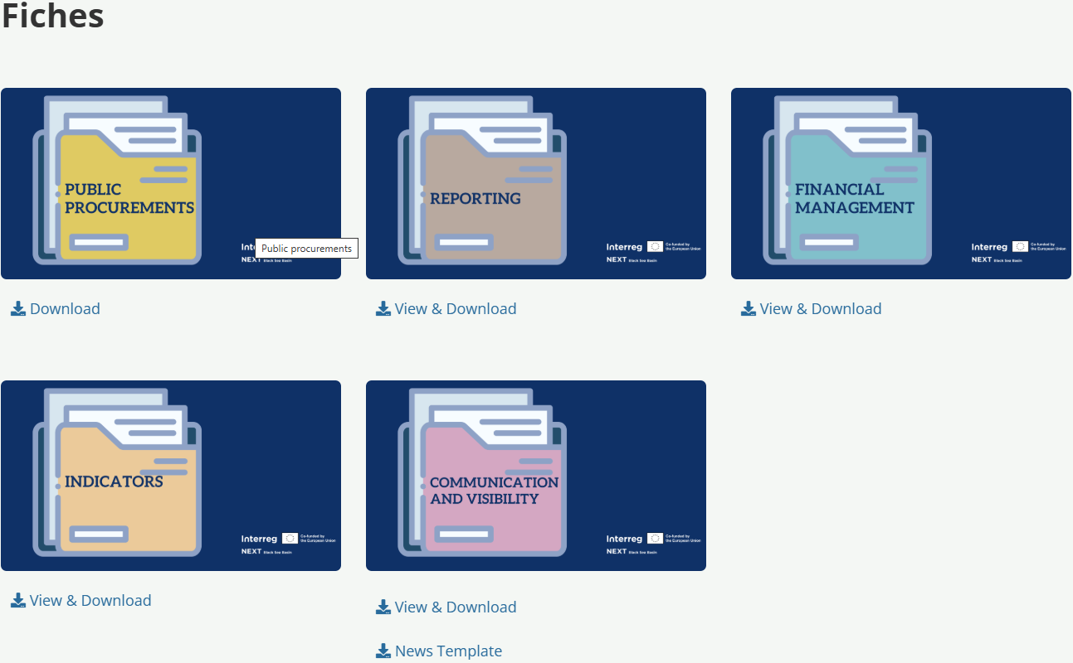
FINANCIAL & REPORTING ASPECTS
PROGRAMME FICHES
https://www.blacksea-cbc.net/interreg-next-bsb-2021-2027/project-toolkit/fiches

Slide 16
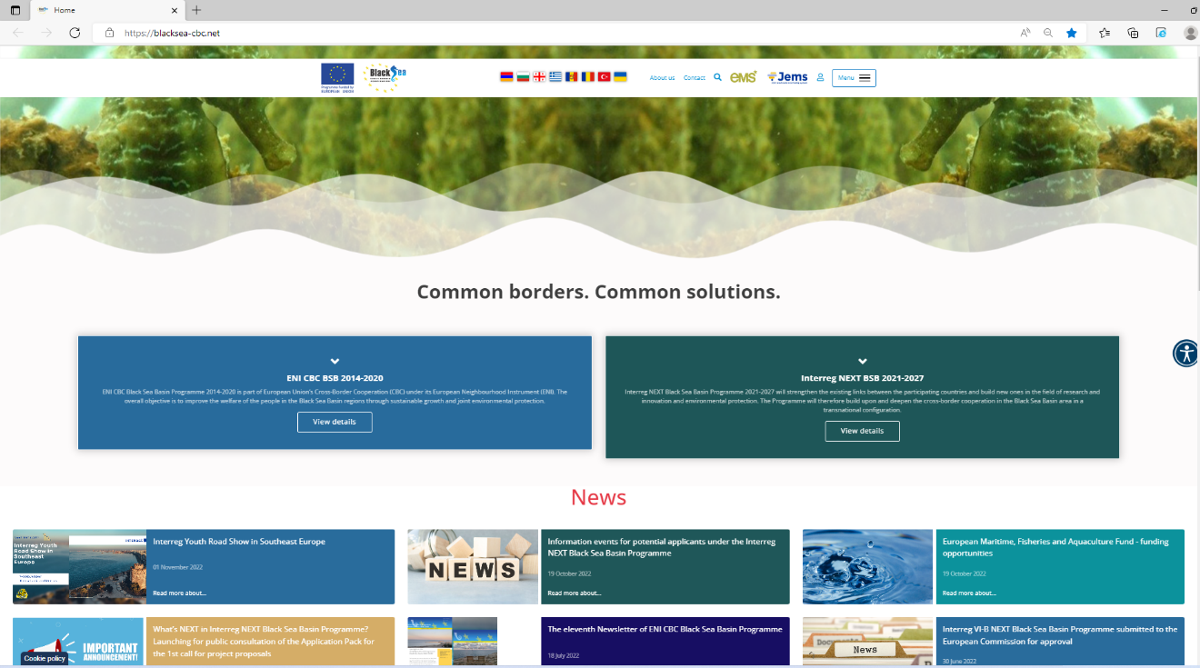
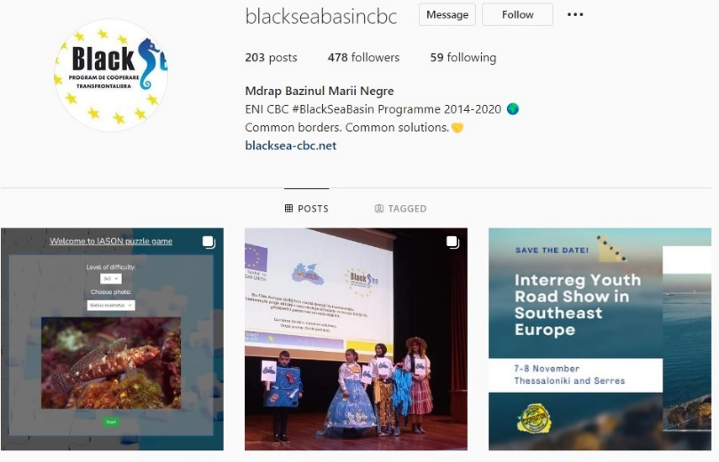
www.facebook.com/BlackSeaBasin/
Help desk:
office@bsb.adrse.ro
www.blacksea-cbc.net
www.instagram.com/blackseabasincbc/

