Slide 1
From ENPI CBC to ENI CBC in the Black Sea Basin Istanbul 5 December 2013
Some CPMR views

Slide 2
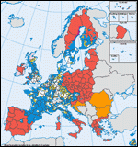
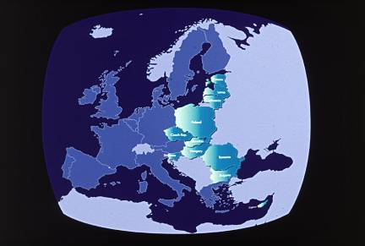
CPMR, SET UP IN 1973 ON THE BASIS OF A THREE FOLD OBSERVATION
Need for greater involvement of the Regions in European integration
Disparities in competitiveness between the central part of Europe and its peripheries
Insufficient enhancement of Europe’s maritime interfaces

Slide 3
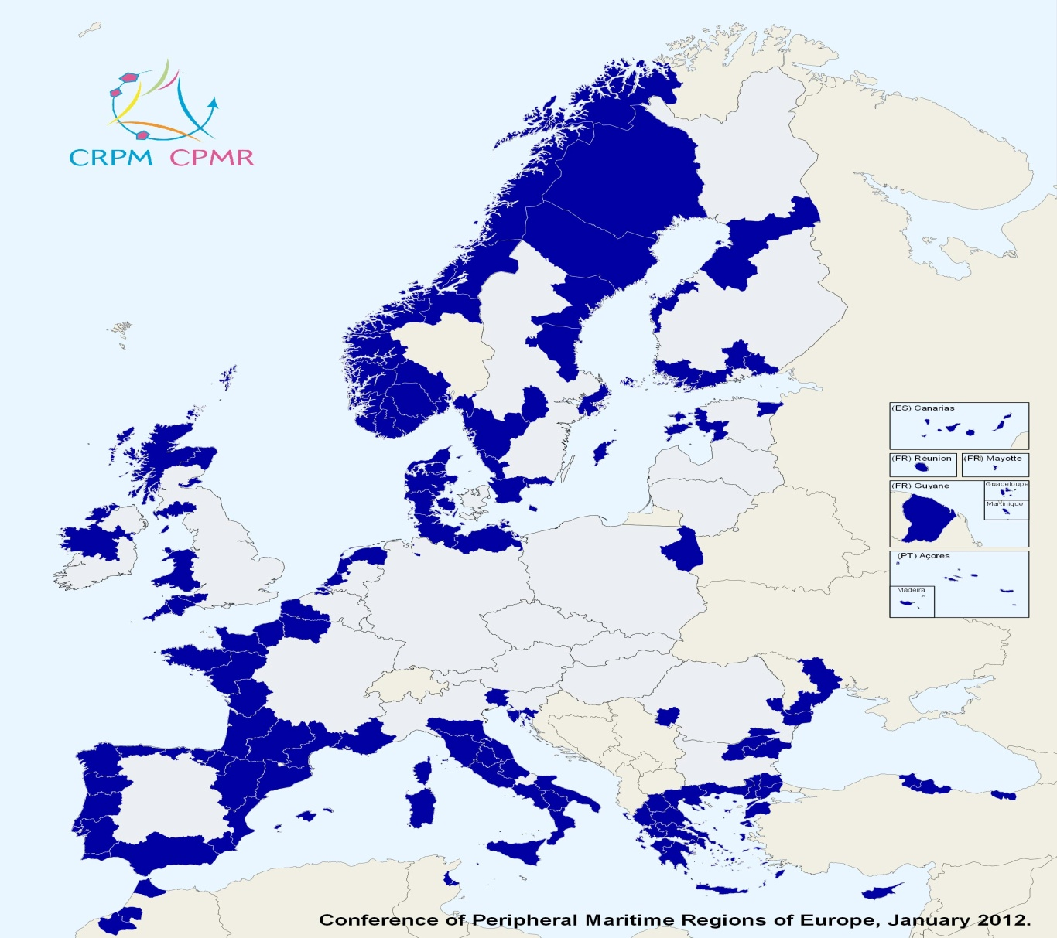
MEMBERS
150 Regions
28 EU member and non-member States
200 million inhabitants
6 Geographical Commissions

Slide 4
A COMMON ORGANISATION AND 6 GEOGRAPHICAL COMMISSIONS
Conférence des
Régions
Périphériques
Maritimes
North Sea Commission
Baltic Sea Commission
Islands Commission
Conference of Peripheral Maritime Regions of Europe
Balkan and Black Sea Regional Commission
Atlantic Arc Commission
Intermediterranean Commission

Slide 5
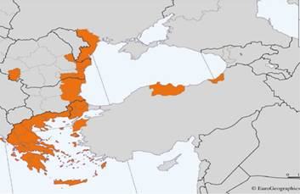
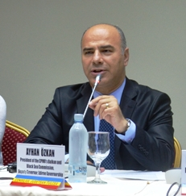
CPMR Balkan and Black Sea Regional Commission President: Dr Ayhan Ozkan Deputy Governor Edirne, Turkey Headquarters located in Kavala, Greece

Slide 6
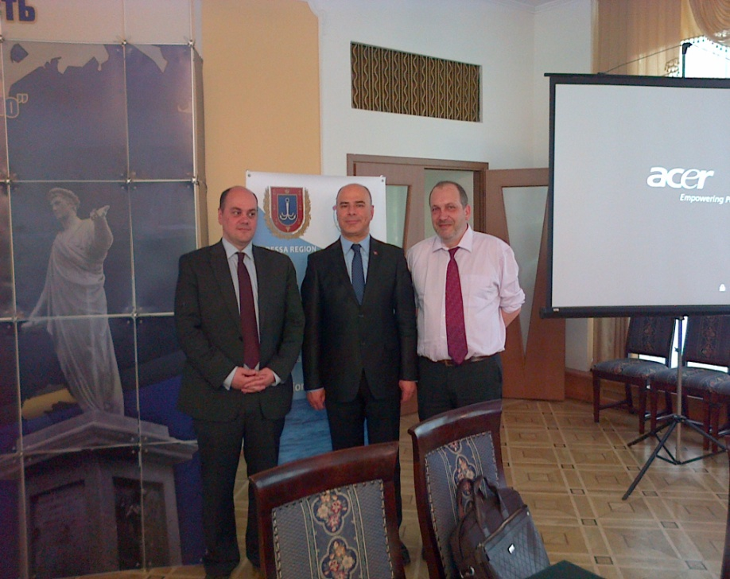
Turkish Provinces: increasingly committed to the CPMR/BBSRC Canakkale, Edirne, Kirklareli, Samsun, Sinop, Tekirdag and Trabzon Provinces

Slide 7
We are a “lobby” of regional authorities vis-à-vis the EU

Slide 8
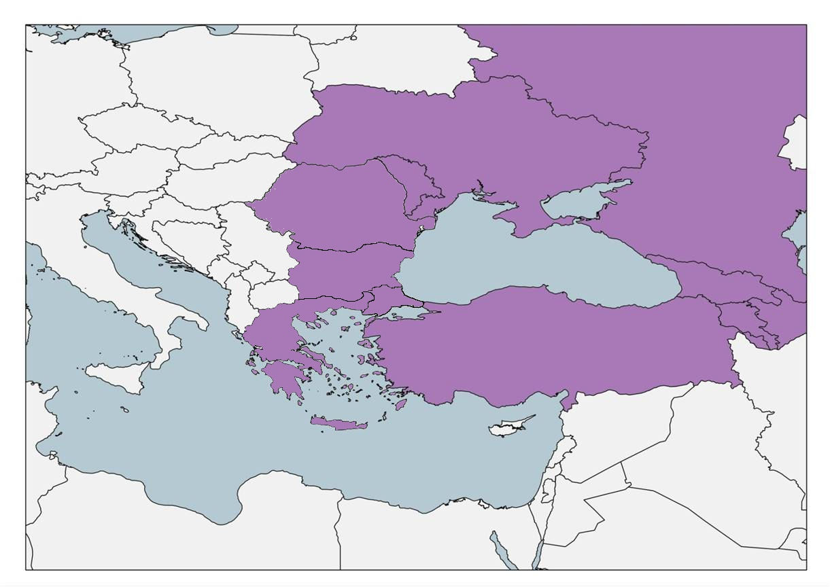
“CPMR, NOT JUST AN INTEREST GROUP, BUT A THINK TANK FOR EUROPE”: we support the launch of Macro-regional and Sea Basins Strategies
SINOP DECLARATION
22 June 2012 in Sinop, Turkey: “More 4 More”- More support for the Black Sea Strategy, More activities in the Adriatic, More coherence between macro-regions and neighbourhood programmes, More regional involvement at EU level!

Slide 9
Let’s be specific: participate in the ENI Black Sea Basin Programme 2014-2020 is a key priority for the BBSRC Regions
“Regions” probably not sufficiently present in current ENPI programme/projects :
Lack of budget (matched funding)
Lack of legal competences
Lack of services and expertise
Transnational, interregional capacity building only “emerging”
...
However, with the support of the CPMR BBSRC, and gaining experience from more advanced areas, they are preparing the next period

Slide 10
ESTABLISHING THE TECHNICAL ORGANISATION OF THE BALKAN AND BLACK SEA COMMISSION in line with the BSB programme calendar/priorities
Saint-Malo 25 September 2013

Slide 11
Select a limited number of priorities/working groups and provide each of them with an organisational structure and a work schedule for two years
Tourism, entrusted to Krentiki Makedonia (EL), Business Cooperation, to the Province of Sinop (TU), and External Cooperation to Odessa (UA)
Terms of Reference, specific priorities and a timetable for action over two years
The composition of the working group is important. The participants must have genuine expertise and experience
Each Lead Region will report on the results obtained to the annual BBSRC General Assembly: next GA in Edirne, June 2014
We need to develop “transnational BSB capacity building” together!

Slide 12
Participate in the CPMR thematic working groups
ENERGY & CLIMATE CHANGE
EXTERNAL COOPERATION
MACRO-REGIONS
TRANSPORT
TOURISM
MARITIME ISSUES
FISHERIES
INTEGRATED COASTAL ZONE MANAGEMENT/ MARITIME SPATIAL PLANNING
MARITIME SAFETY
SHIPBUILDING

Slide 13
Provide the BBSRC with a genuine medium-term Business Plan
After this new technical organisation has been in operation for one year, an update will be made and give rise to the preparation of a medium-term plan…
which will be implemented during the next programming period of European policies: 2014 – 2020
And feed into the ENI programme with valuable projects in the 4 priority Thematic Objectives whatever they may be when finally decided: all of interest for regional development, with TO5 (local and regional governance) surely not to be neglected
Just an example Black Sea Vasco da Gama: a sort of “Maritime Erasmus” in the BS (TO2)

Slide 14
International Conference on SEAFARERS’ EDUCATION, TRAINING & CREWING 24th of April 2013 Odessa

Slide 15
Vasco da Gama: Training for greener and safer maritime transport

Slide 16
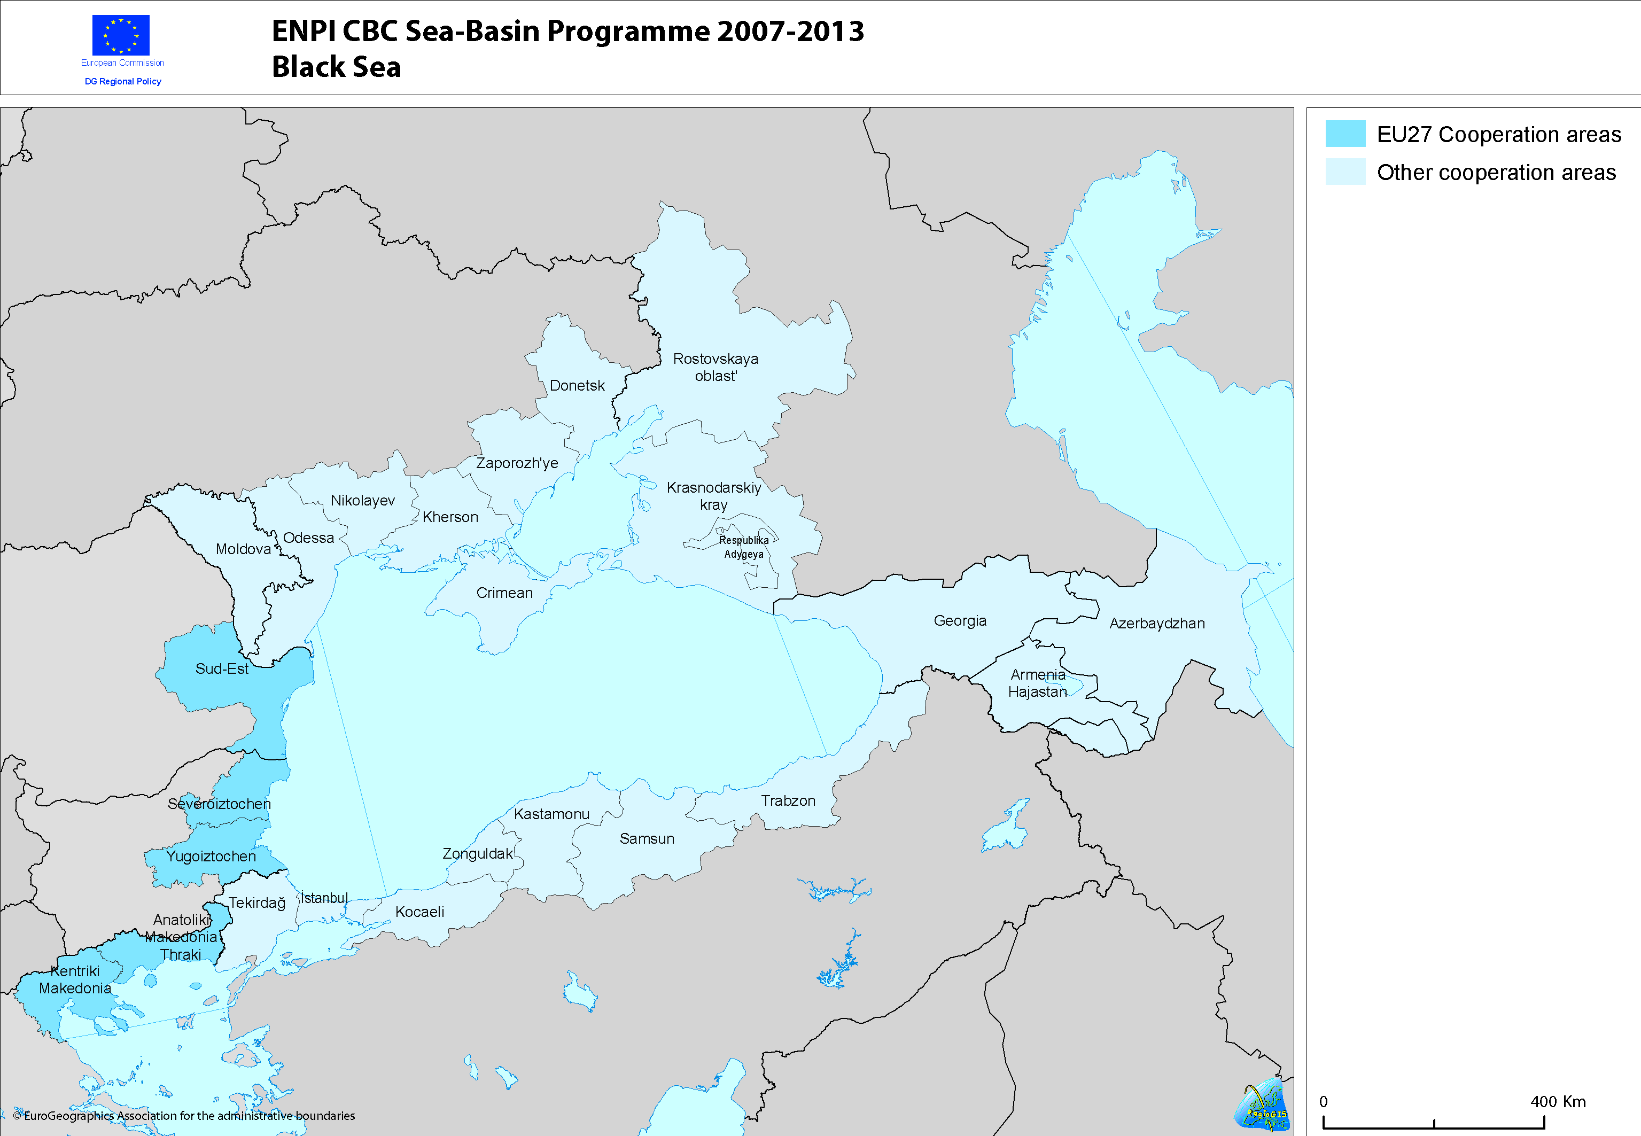
Eligible area
3 – Next steps : Vasco da Gama as a label - regional implementation in Sea Basins : up to you !

Slide 17
In conclusion: - We are available to help - We also believe participating in the programme will help the BS regional authorities to gain maturity, experience and European know-how - and our door is always open to Regions interested in joining!
Thank you for your attention
Teşekkür ederim !

